Slide 1

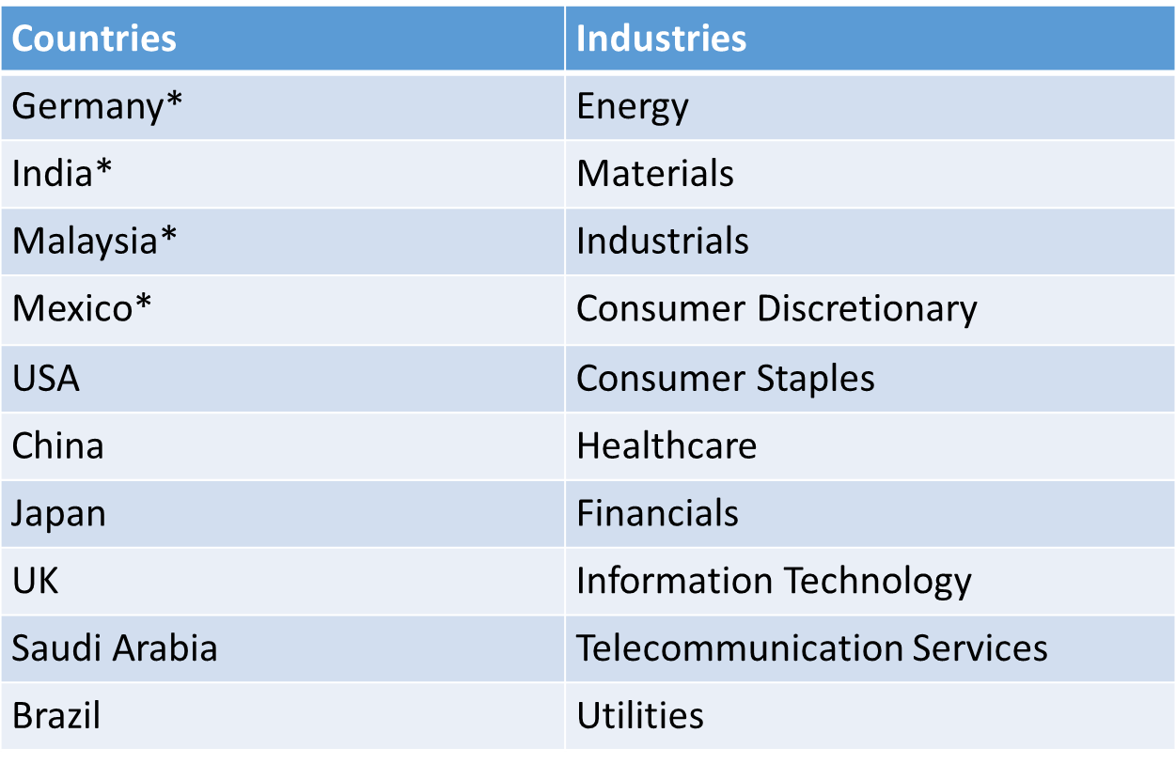
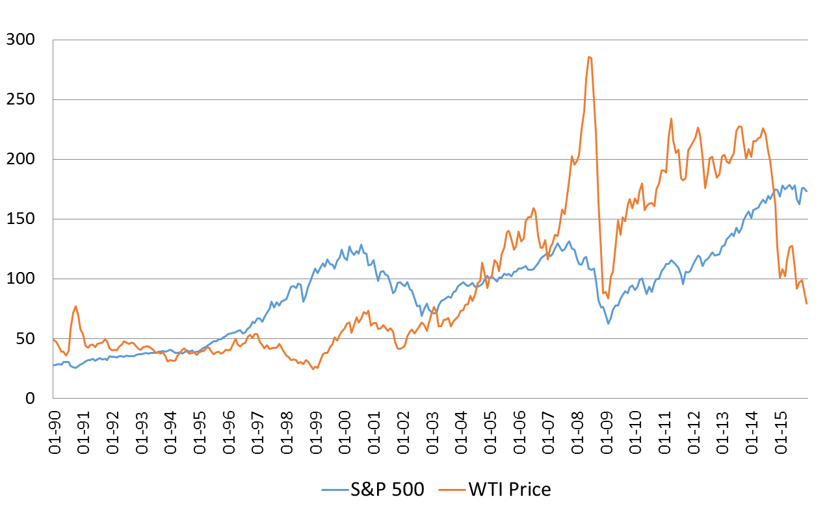
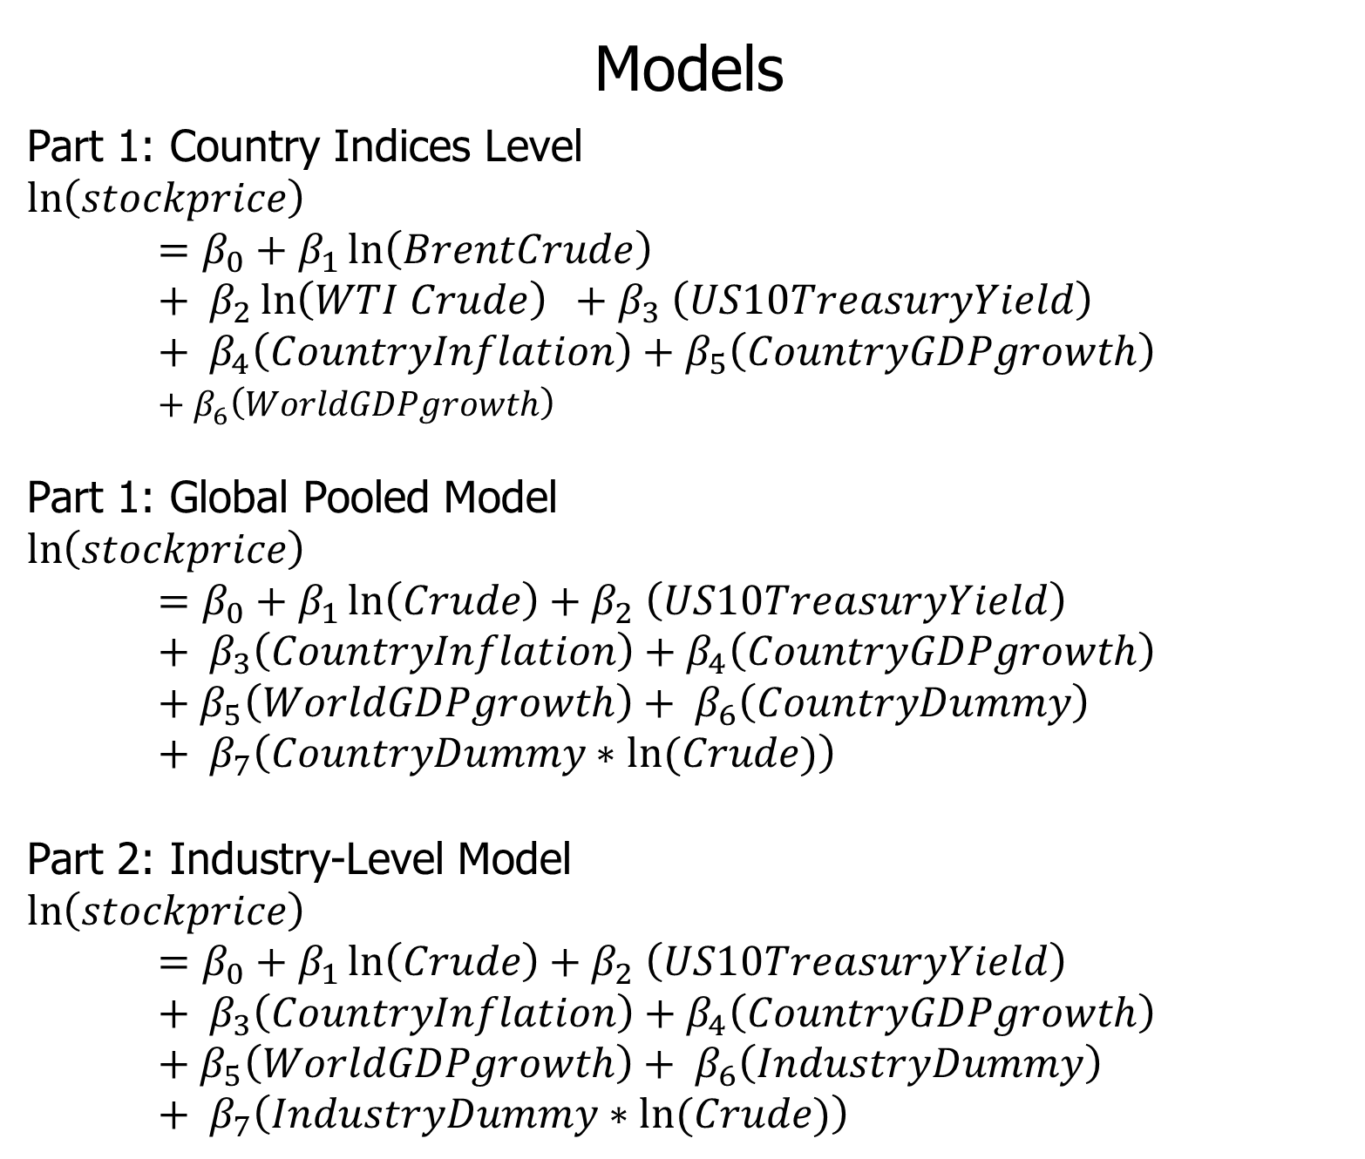
Does Oil Drive the Bull and Bear?:
An Industry-Level Analysis Across Oil Importers and Exporters
Rahul Dutt ‘16 – (Sponsor: Professor David Cuberes)
Background
As shown by the graph below oil markets and financials markets move together, though oil is much more volatile. Oil prices are said to influence the stock market in two ways. Firstly, if oil is taken as an input, higher oil prices leads higher costs to the producer and as a result decreases profit and their cash flow, which leads to lower stock price. This shows a negative relationship. We can see this today with low oil prices and high stock market valuations. On the other hand, high oil prices indicate that the economy is doing well, and the high demand pushes up the stock price as well. This implies that is has a positive relationship. We see evidence of this at the peak of the Housing Bubble where stock prices were soaring along with record high oil prices (as seen in graph).
Results
On an international level, crude plays a positive role in all the countries in the study, besides Japan. Oil also impacts the stock market in large oil exporters and importers more, namely India, Mexico and Saudi Arabia. On an industry level, there is no clear relationship between oil, industry and the stock market. Though Healthcare, Consumer Staples, Industrials, Materials and Utilities when interacted with oil have a relatively larger impact on the stock market than other industries. The results are inconclusive.
Results: Part 1
Models
Part 1: Country Indices Level
$$\ln\left(stockprice\right)=β_{0}+β_{1}\ln\left(BrentCrude\right)+ β_{2}\ln\left(WTI Crude\right) {+ β}_{3}\left(US10TreasuryYield\right)+ β_{4}\left(CountryInflation\right)+β_{5}\left(CountryGDPgrowth\right)+β_{6}\left(WorldGDPgrowth\right)$$
Part 1: Global Pooled Model
$$\ln\left(stockprice\right) =β_{0}+β_{1}\ln\left(Crude\right){+ β}_{2}\left(US10TreasuryYield\right)+ β_{3}\left(CountryInflation\right)+β_{4}\left(CountryGDPgrowth\right)+β_{5}\left(WorldGDPgrowth\right)+ β_{6}\left(CountryDummy\right)+ β_{7}\left(CountryDummy∗ln(Crude)\right)$$
Part 2: Industry-Level Model
$$\ln\left(stockprice\right)=β_{0}+β_{1}\ln\left(Crude\right){+ β}_{2}\left(US10TreasuryYield\right)+ β_{3}\left(CountryInflation\right)+β_{4}\left(CountryGDPgrowth\right)+β_{5}\left(WorldGDPgrowth\right)+ β_{6}\left(IndustryDummy\right)+ β_{7}\left(IndustryDummy∗ln(Crude)\right)$$
Results: Part 1 - Global
*Indexed to January 2005
Theory
Using the Rational Valuation Formula, asset price is determined by the sum of the future value of free cash flows and dividends discounted at the appropriate risk adjusted rate. This is also the method used by Wall Street analysts to price stocks in their portfolios and to make calls on whether to buy or sell a stock. It is a fundamental analysis using financial accounting to calculate the future growth and earnings of the company.
At a micro level, in the short-run, the level of output is held constant as the firm must honor its contracts, and cannot change the other factors as easily when there is an impact on one. Thus, if oil prices go up, the firm must continue their usage of energy as an input at the same level to meet their output goals, and vice versa. At the same time, in the short-run, it is difficult for firms to push a cost increase onto its consumers. As a result, the cost increase impacts their profit margins and cash flow.
Results: Part 2 – Industry-Level Analysis
Data
Company, price and industry data was gotten from the Bloomberg terminals by Bloomberg L.P. Country level data for GDP and inflation along with World GDP annual growth rates were obtained from the World Data Bank by the World Bank. WTI and Brent Crude monthly closing prices were sourced from the Energy Information Administration. US 10-year treasury monthly rates were obtained from the Federal Reserve of St. Louis.
Conclusion
Though the results are inconclusive on the industry level as industries in different countries have signs when interacted with oil, Crude itself plays a large role in the stock market. Developing countries are impacted by oil price more than developed ones (Japan, and Germany) and large oil importers/exporters also share a strong relationship between oil and the stock market. However, macro economic indicators all have the expected signs. Also, industries where cost cannot be easily pushed to consumers see a greater impact due to oil in the stock market.

